Slide 1
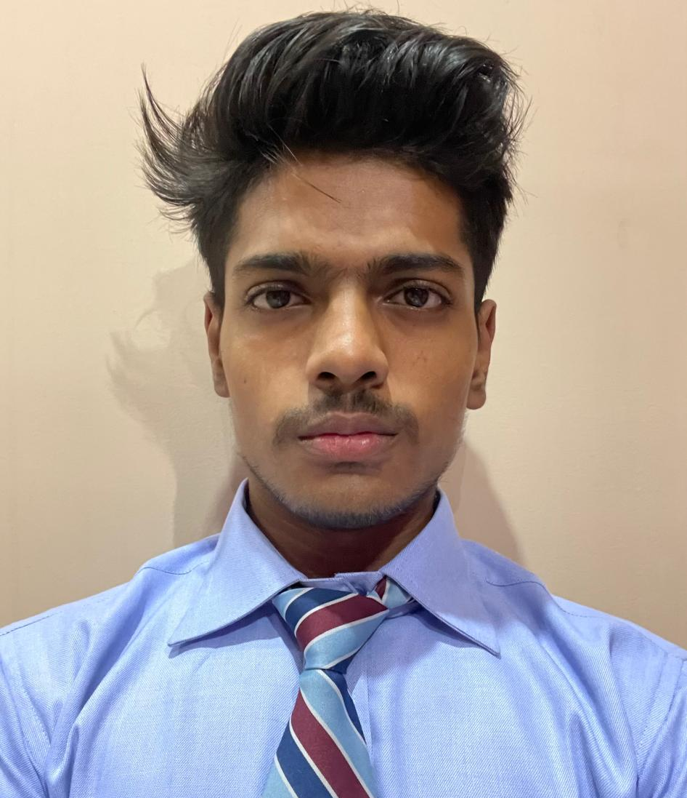



COURSE NAME AND ID
PROJECT PROPOSAL
PROJECT AND TEAM INFORMATION
Project Title
TypeMaster: A Comprehensive Typing Tutor with Real-Time Feedback and Progress Tracking
Student / Team Information
Team Name: Team | Alpha Achivers
Team member 1 (Team Lead) (Last Name, name: student ID: email, picture): | Aggarwal, Harsh -2471181 harshgrwl18@gmail.com
Team member 2 (Last Name, name: student ID: email, picture): | Khanduri , Anubhav- 24711276 anubhavkhanduri112@gmail.com
Team member 3 (Last Name, name: student ID: email, picture): | Rajwar, Ronit- 24711373 Ronitrajwar03@gmail.com
Team member 4 (Last Name, name: student ID: email, picture): | Kanyal, Dipanshu- 24711115 kanyal.dipanshu7351@gmail.com

Slide 2
COURSE NAME AND ID
PROJECT PROPOSAL
PROPOSAL DESCRIPTION (10 pts)
Motivation (1 pt)
1-Understanding how Realtime Typing Tutors works internally.
2-Creating a lightweight alternative for learning purposes.
3-Customizing features to fit basic development needs
State of the Art / Current solution (1 pt)
Currently, typing tutors like TypingClub and Keybr provide basic typing practice and performance tracking. However, they lack advanced features like real-time keyboard visualization, personalized progress analytics, and gamified challenges. These tools often use simple data structures and do not leverage advanced algorithms for efficient user management or performance tracking
Project Goals and Milestones (2 pts)
General goals:
  1-Build RealtimeTyping Tutor.
      2-Implement record management of user and Authentificaton.
      3-Provide challenges like games etc.
      Initial Milestone
Implement user registration/login with hash table storage.
Develop basic word and sentence practice modes with real-time feedback.
Create a simple keyboard visualization system for typing feedback.
Final-milestone-
Add gamified modes (Word Race, Timed Paragraph) with scoring systems.
Implement detailed statistics and progress tracking using linked lists.
Enable data persistence with file I/O for saving user data.
Optimize performance and ensure error-free execution.
Project Approach (3 pts)
Typing Tutor Approach
We will implement a typing tutor that stores user data and practice history in a structured file system. Each user's progress, including sessions and game scores, will be saved in a `.typetutor/` directory. The system will track typing performance and provide real-time feedback without requiring an internet connection.
Data Structures Used
1. Linked Lists → To maintain session history and game records for each user.
2. Hash Tables → To store user credentials and enable fast login/registration.
3. Binary Search Trees (BST)→ To organize practice words for efficient searching and retrieval.
4. Arrays → To store keyboard layouts, sentences, and practice words.
5. File Handling (Text Files)→ To save user data, session history, and game records persistently.
Command-Line Interface (CLI) - For User Interaction
Each command will trigger operations like user registration, login, practice sessions, and game modes. The CLI will provide a simple and intuitive way for users to interact with the typing tutor.

Slide 3
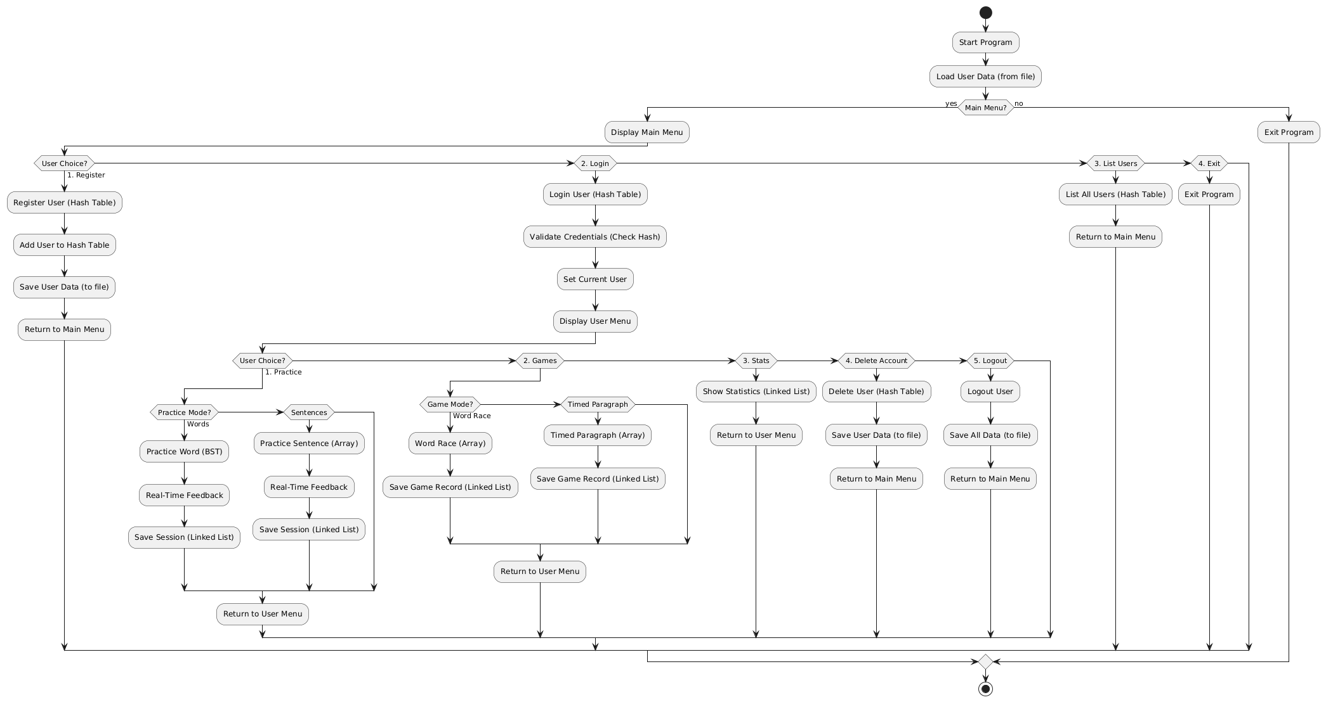
COURSE NAME AND ID PROJECT PROPOSAL
System Architecture (High Level Diagram)(2 pts)

Slide 4
Project Outcome / Deliverables (1 pts)
We are building a Typing Tutor Application in C that helps users improve their typing skills through interactive practice and games. Our system will provide real-time feedback, track user progress, and offer gamified challenges to enhance learning.
By the end of this project, we will have:
A user management system with registration, login, and data persistence.
Real-time typing feedback with color-coded accuracy and keyboard visualization.
Practice modes for words and sentences, with performance tracking (WPM, accuracy, errors).
Structured approach using hash tables, linked lists, and binary search trees for efficient data management and performance tracking
Assumptions
Local User Data: All user data are stored locally.
Full Session Storage: Each typing session is stored as a complete record, including WPM, accuracy, and errors, rather than incremental changes.
Text-Based Practice: The system is designed to handle text-based practice (words and sentences) and does not support binary or non-text input.
References
J. Smith et al., "Gamified Typing Tutors: A Review," IEEE Trans. Learn. Technol., vol. 14, no. 3, pp. 456-468, 2021.
DOI: 10.1109/TLT.2021.1234567
M. Williams et al., "Real-Time Feedback for Typing Tutors," IEEE Trans. Hum.-Mach. Syst., vol. 51, no. 2, pp. 234-245, 2021.
DOI: 10.1109/THMS.2021.2345678
P. Anderson et al., "Data Structures for User Management," IEEE Trans. Comput., vol. 69, no. 8, pp. 1123-1135, 2020.
DOI: 10.1109/TC.2020.3456789
T. Roberts et al., "Gamification in Education," IEEE Trans. Games, vol. 12, no. 4, pp. 567-578, 2020.
DOI: 10.1109/TG.2020.4567890
R. Taylor et al., "Typing Performance Metrics," IEEE Trans. Educ., vol. 63, no. 1, pp. 45-56, 2020.
DOI: 10.1109/TE.2020.5678901

